Slide 1
Pediatric Opioid REMS (Risk, Evaluation, and Mitigation Strategies)
Pediatric Pain Resource Nurse Curriculum
Notes:
Materials:
Flip chart or whiteboard
Markers
Room Setup:
• In tables of 4 or 6-8 depending on number of participants
Display slide as participants walk in
This session is 45 minutes
Welcome and Introductions: Introduce facilitator if necessary
READ: The learning objectives for this section are:
Define substance misuse, abuse, addiction, tolerance, physical dependence, and pseudo-addiction:
Develop a plan of care for patients requiring opioids as a medication in their multimodal pain treatment plan, include: risk assessment, monitoring for misuse, adverse effects, and safe methods to discontinue opioids if ineffective for treating pain or abuse identified.
Educate healthcare providers, patients, parents/guardians & the public on methods to secure, monitor & dispose of opioids.
© 2017 Manworren & Lurie Children’s Hospital
All rights reserved. Version 2019

Slide 2
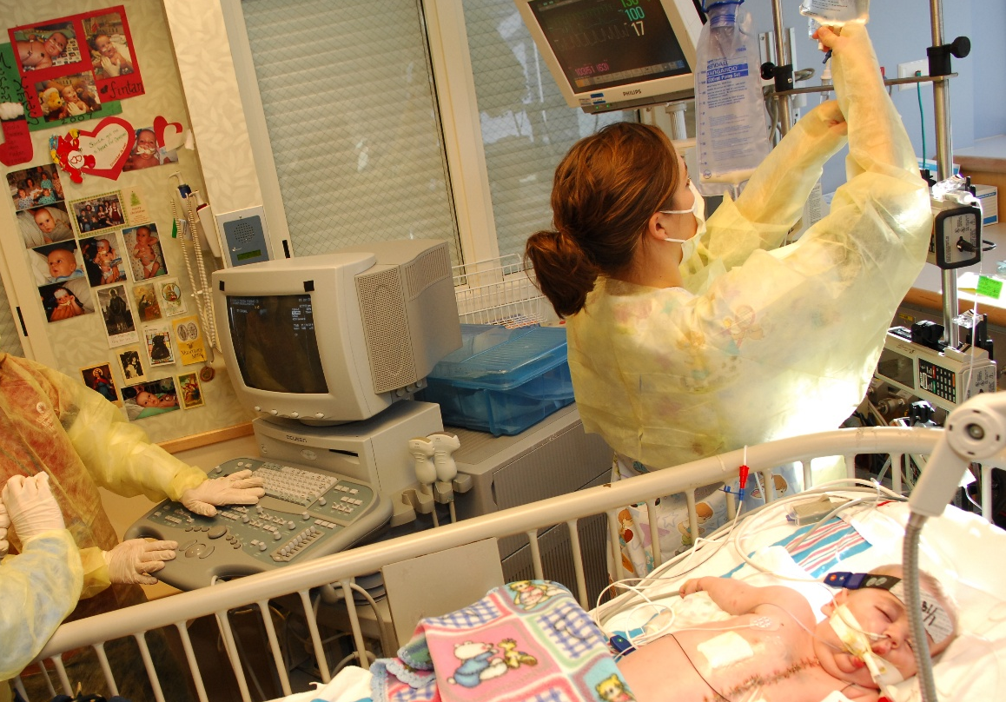
Opioids
Opioids are indicated for severe pain
Healthcare professionals
must advocate for:
Appropriate multimodal pain and opioid risk assessment,
Optimal pain treatment, and
Monitoring for adverse opioid effects
Sedation, Respiratory depression
Opioid use disorder
Constipation
Anticipatory guidance for safe opioid use at home
Notes:
READ:
Healthcare professionals must advocate for appropriate pain assessment and optimal multimodal pain treatment, which may include the use of opioids.
Healthcare professionals must also monitor for adverse treatment effects, including adverse effects from opioids, like respiratory depression and opioid use disorder.
Healthcare professionals are critical for providing anticipatory guidance for safe opioid use at home.
© 2017 Manworren & Lurie Children’s Hospital
All rights reserved. Version 2019

Slide 3
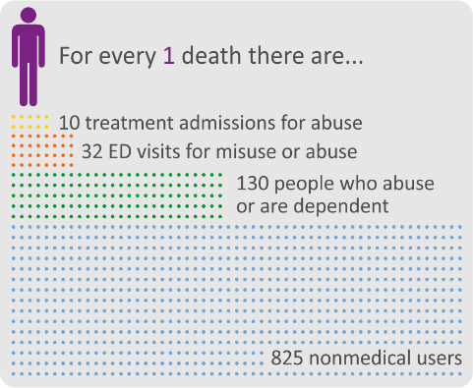
The Opioid Epidemic In 2015: unintentional overdose deaths increased by 11 % to 52,404. By comparison: People who died in car crashes increased by 12 % to 37,757. Gun–related homicides & suicides, increased by 7% to 36,252
Less than 1% of individuals treated for pain become addicted to opioids (Marks & Sachar, 1973; Porter & Jick, 1980)
We were wrong. Pain does not protect patients from opioid use disorder
Kochanek KD, et al. National Vital Statistics Report 2011;60:1-117. CDC Vital Signs. Prescription Painkiller Overdoses. Use and abuse of methadone as a painkiller. 2012. Warner M, et al. Drug poisoning deaths in the United States, 1980-2008. NCHS data brief, no 81. Hyattsville, MD: National Center for Health Statistics. 2011. National Center for Injury Prevention and Control. Division of Unintentional Injury Prevention. Policy Impact. Prescription Painkiller Overdoses. Nov 2011.
Notes:
READ:
Prescription opioid misuse and opioid use disorder are at epidemic levels, and deaths from opioid misuse now outnumber deaths from car crashes.
We were wrong. Pain does not protect patients from opioid use disorder. In the US, estimates of substance use disorder range from 6 to 15% . Therefore the risk of opioid use disorder in the general population is 6 to 15%; NOT less than 1% as many of us were taught.
Healthcare professionals can dramatically curb opioid misuse by communicating the facts, monitoring opioid use, and providing patients and families with evidence-based anticipatory guidance
© 2017 Manworren & Lurie Children’s Hospital
All rights reserved. Version 2019

Slide 4

Differentiate between the following terms:
Drug abuse
Drug misuse
Nonmedical use
Drug diversion
Tolerance
Physical dependence
Pseudo-addiction
Addiction
Substance use disorder
Notes:
READ: These terms are often used interchangeably despite their different definitions, which contributes to confusion among healthcare professionals.
ASK : What is the difference between the following terms:
Drug abuse and Drug misuse Select participants willing to share their responses [Limit to 1 minute]
Nonmedical use and Drug diversion Select participants willing to share their responses [Limit to 1 minute]
Tolerance, physical dependence and pseudo-addiction Select participants willing to share their responses [Limit to 1 minute]
Addiction use and substance use disorder Select participants willing to share their responses [Limit to 1 minute]
[10 minutes of 45 minute session is complete]
These are the specific differences If clarification is needed:
Abuse is use of a drug for nontherapeutic, recreational purposes, psychotropic, or euphoric effects whereas Misuse is use of a drug prescribed for a medical purpose in a manner inconsistent with its intended purpose or prescribed use.
Nonmedical use is use of a prescription drug by someone other than the person for whom it was prescribed, or in a manner for which it was not prescribed—for example, to achieve a euphoric effect, increasing dose without prescriber approval, unknowingly taking a larger dose than directed (misuse), or using the drug to attempt suicide or to make a suicidal gesture (suicide not intended), whereas Drug diversion is the illicit redirection of legitimately prescribed drugs.
Tolerance is the need for increased amounts of the drug in order to achieve the same therapeutic effects, whereas physical dependence is a physiologic and biochemical adaptation of neurons to the drug and abstinence from the drug precipitates symptoms of withdrawal.
Pseudoaddiction is vigilance in timing (watching the clock) and drug dose, often due to undertreatment of pain. This resolves when pain is controlled or relieved. In contrast, Addiction is a primary chronic neurobiological disease of reward, motivation, and memory and related circuitry, characterized by the “four Cs”: Compulsive use, impaired Control over use, Continued use despite harm, and strong Craving.;
Substance use disorder is a newer term that replaces addiction. This is a maladaptive pattern of substance use leading to clinically significant impairment or distress, demonstrated by a recurrence of 2 or more of the events or behaviors listed in your participant guide within a year.
© 2017 Manworren & Lurie Children’s Hospital
All rights reserved. Version 2019

Slide 5
Opioid misuse is a major public health problem
Age | Lifetime | Past Year | Past Month
12-17 years | 9.4% | 3.9% | 1.7%
18-25 years | 24.4% | 8.5% | 2.4%
Opioids are prescribed to teenagers 15-19 years of age, at over 5% of their emergency department (ED) visits, including 15% of visits for injuries.
SAMHSA. (2016). Results from the 2015 National Survey on Drug Use and Health: National Findings. Office of Applied Studies, National Survey on Drug Use & Health Series
Boyd CJ, et al. J Adolesc Health. 2009;45:543-50. Johnston LD, et al. Monitoring the Future National Results on Adolescent Drug Use. Overview of Key Findings, 2009. Bethesda, MD: National Institute on Drug Abuse. 2010.
Notes:
READ:
Leftover prescription opioids are a common source of misused opioids
For example: Of 749 oxycodone and hydrocodone pills dispensed to 49 adolescents after appendectomy, 167.5 (24%) were reported as used as prescribed, 53.5 pills (8%) were unaccounted for by pill count, and 488 pills (68% or 2/3rd of the number prescribed) were returned to families for disposal.
Over 1% of teenagers 12-17 years of age report opioid misuse in the past month, 19% in the past year, and almost 10% during their short lifetime
By 25 years of age 1 in 4 young adults report that they have misused prescription opioids.
© 2017 Manworren & Lurie Children’s Hospital
All rights reserved. Version 2019

Slide 6
How do you tell your patients and their guardians to store, monitor, and dispose of opioids prescribed for pain?
Notes:
READ: With your table discuss your answers to the question on this slide, and discuss how you could systemize this anticipatory guidance for securing opioids in patient’s homes. Select a participant willing to share your groups’ answers. This is a 5 minute activity.
[Give groups 5 minutes to discuss]
Select groups to share their answers
[Limit to 1minute/group; total of 4 minutes]
READ:
Make sure you always include instructions to keep medications in a SECURE place, (for example a locked cabinet or medication safe) and to
Dispose of unneeded medications by taking them to a drug disposal site
[20 minutes of 45 minute session is complete]
© 2017 Manworren & Lurie Children’s Hospital
All rights reserved. Version 2019

Slide 7
Opioid dosing: ROSTERS
Risk assessment
Optimize multimodal for opioid-sparing effect
Start low, go slow
Titrate to effect
Evaluate efficacy
Reevaluate continued need for opioids
Secure, monitor, and dispose
R
O
S
T
E
R
S
© 2011 Manworren
Notes:
READ:
ROSTERS is an acronym of steps for opioid prescribing; and monitoring your roster of patients prescribed opioids.
READ: slide
© 2017 Manworren & Lurie Children’s Hospital
All rights reserved. Version 2019

Slide 8
Prescribed Use or Abuse?
Notes:
READ:
Over the next 10 minutes, we will review urine drug testing as a method used to monitor for use of prescribed opioids or opioids abuse.
As covered in your participant materials, we will analyze urine drug testing results and discuss next steps in the care of these simulated patients.
© 2017 Manworren & Lurie Children’s Hospital
All rights reserved. Version 2019

Slide 9
Monitor opioid use
Obtain random urine drug screenings to:
Help identify drug misuse before and during opioid treatment
Confirm prescribed opioid use.
Support decision to refer.
Testing frequency is based on clinical judgment.
If patient displays aberrant behavior, UDT alone is not sufficient to document adherence to treatment plan.
Check state regulations for requirements.
+
Notes:
READ: State laws may have specific requirements for monitoring opioid use. For example, some states require the prescription drug monitoring program be checked before every opioid prescription; other states require more limited checks, and still others don’t legally require checks. Be aware of the requirements in your state.
ASK: How often should patients receiving prescribed opioids have urine drug testing in order to confirm the patient is actually taking the prescribed opioid?
Select participants willing to share their responses to these questions.
Write on flipchart or board [Limit to 2 minute]
READ: While testing frequency is based on clinical judgment, a standard should be established to prevent biased testing of individuals of certain gender, age, race/ethnicity, diagnosis, or socioeconomic status.
© 2017 Manworren & Lurie Children’s Hospital
All rights reserved. Version 2019

Slide 10
Examples of opioid metabolism
Codeine | ➔ | Morphine | ⬅ | 6-MAM | ⬅ | Heroin
⬇ |  | ⬇ |  | t½=25-30 min |  | t½=3-5 min
Hydrocodone | ➔ | Hydromorphone
Oxycodone | ➔ | Oxymorphone |  | 6-MAM=6-monoacetylmorphine
Notes:
READ:
This slide shows some examples of opioid metabolism. It is not a diagram of comprehensive pathways, but may explain presence of apparently un-prescribed drugs.
I’ll use the first case as an example of how to read and interpret urine drug test results.
© 2017 Manworren & Lurie Children’s Hospital
All rights reserved. Version 2019

Slide 11
Medication prescribed: Oxycodone
Analyte | Results | Comment | Cut-off | Unit
Amphetamines | Negative |  | 500 | ng/mL
Barbiturates | Negative |  | 200 | ng/mL
Benzodiazepines | Negative |  | 75 | ng/mL
Buprenorphine/metabolite | Negative |  | 5 | ng/mL
Cannabinoids | Negative |  | 20 | ng/mL
Cocaine metabolite | Negative |  | 150 | ng/mL
Fentanyl | Negative |  | 1.0 | ng/mL
Methadone metabolite | Negative |  | 100 | ng/mL
Opiates | POSTIVE |  | 50 | ng/mL
Hydrocodone, Quant | POSITIVE | INCONSISTENT 165 | 10 | ng/mL
Hydromorphone, Quant | POSITIVE | INCONSISTENT 68 | 10 | ng/mL
Oxycodone | Negative | INCONSISTENT | 10 | ng/mL
Oxymorphone | Negative |  | 10 | ng/mL
Alcohols | Negative |  | 0.02 | %
Acetaminophen | Negative |  | 10 | ug/mL
Creatinine | Normal | 50 | 5 | mg/dL
pH |  | 6.8
Notes:
READ: Oxycodone was prescribed as noted at top of slide.
If oxycodone was taken in the past 2-3 days, the urine drug test will be opiate, oxycodone & oxymorphone positive.
The results show urine is opiate positive, but negative for oxycodone and it’s metabolite, oxymorphone.
Unexpectedly, hydrocodone and it’s metabolite, hydromorphone, are detected in the urine! Hydromorphone is also an opiate.
These urine drug test results suggest the patient has not taken the prescribed oxycodone, but has taken hydrocodone and may have taken hydromorphone in the last 2-3 days.
ASK: So now what do you want to do?
READ: Raise your hand to indicate which of these 4 actions you would recommend:
Discontinue prescribing and report patient/family to authorities
Refer patient/family to a substance abuse treatment program
Share finding with patient and/or family (based on laws) and assess suspected lack of treatment plan adherence
Prescribe oxycodone for a limited time to wean patient off opioids and establish another treatment plan.
© 2017 Manworren & Lurie Children’s Hospital
All rights reserved. Version 2019

Slide 12
Medication prescribed: Oxycodone
Analyte | Results | Comment | Cut-off | Unit
Amphetamines | Negative |  | 500 | ng/mL
Barbiturates | Negative |  | 200 | ng/mL
Benzodiazepines | Negative |  | 75 | ng/mL
Buprenorphine/metabolite | Negative |  | 5 | ng/mL
Cannabinoids | Negative |  | 20 | ng/mL
Cocaine metabolite | Negative |  | 150 | ng/mL
Fentanyl | Negative |  | 1.0 | ng/mL
Methadone metabolite | Negative |  | 100 | ng/mL
Opiates | POSTIVE |  | 50 | ng/mL
Hydrocodone | Negative |  | 10 | ng/mL
Hydromorphone | Negative |  | 10 | ng/mL
Oxycodone, Quant | POSTIVE | CONSISTENT, 52 | 10 | ng/mL
Oxymorphone, Quant | POSTIVE | CONSISTENT, 36 | 10 | ng/mL
Alcohols | Negative |  | 0.02 | %
Acetaminophen | Negative |  | 10 | ug/mL
Creatinine | Normal | 50 | 5 | mg/dL
pH |  | 6.8
Notes:
ASK: Who wants to explain these results to the group?
Select participants willing to share their responses to this question.
Write on flipchart or board [Limit to 2 minute]
READ: Case interpretation (if not included by participants):
Oxycodone was prescribed as noted at top of slide.
If oxycodone was taken in the past 2-3 days, the urine drug test will be opiate, oxycodone and oxymorphone positive and negative for other opioids and opiate metabolites.
These urine drug test results suggest the patient has taken oxycodone in the last 2-3 days.
READ: We can NOT determine if the patient took the right dose at the right time and the right frequency.
© 2017 Manworren & Lurie Children’s Hospital
All rights reserved. Version 2019

Slide 13
Medication prescribed: Morphine
Analyte | Results | Comment | Cut-off | Unit
Amphetamines | Negative |  | 500 | ng/mL
Barbiturates | Negative |  | 200 | ng/mL
Benzodiazepines | Negative |  | 75 | ng/mL
Buprenorphine/metabolite | Negative |  | 5 | ng/mL
Cannabinoids | Negative |  | 20 | ng/mL
Cocaine metabolite | Negative |  | 150 | ng/mL
Fentanyl | Negative |  | 1.0 | ng/mL
Methadone metabolite | Negative |  | 100 | ng/mL
Opiates | POSITIVE |  | 50 | ng/mL
Morphine, Quant | POSITIVE | CONSISTENT, 10,000 | 10 | ng/mL
6-monoacetylmorphine, Quant | POSITIVE | INCONSISTENT, 985 | 10 | ng/mL
Codeine, quant | Negative | INCONSISTENT, 852 | 10 | ng/mL
Alcohols | Negative |  | 0.02 | %
Acetaminophen | Negative |  | 10 | ug/mL
Creatinine | Normal | 50 | 5 | mg/dL
pH |  | 6.8
Notes:
ASK: Who wants to explain these results to the group?
Select participants willing to share their response to this question.
Write on flipchart or board [Limit to 2 minute]
READ: Case interpretation (if not included by participants):
Morphine was prescribed as noted at top of slide.
If morphine was taken in the past 2-3 days, the urine drug test will be opiate and morphine positive, and negative for other opioids and opiate metabolites.
This urine drug test indicates the patient is positive for morphine and 6-MAM,.
These results suggest the patient has taken heroin and may or may not have also taken morphine
ASK: What is your next recommendation?
READ: Key point (if not included by participants):
This patient should be immediately referred for substance abuse treatment program
© 2017 Manworren & Lurie Children’s Hospital
All rights reserved. Version 2019

Slide 14
Medication prescribed: Methadone
Analyte | Results | Comment | Cut-off | Unit
Amphetamines | Negative |  | 500 | ng/mL
Barbiturates | Negative |  | 200 | ng/mL
Benzodiazepines | Negative |  | 75 | ng/mL
Buprenorphine/metabolite | Negative |  | 5 | ng/mL
Cannabinoids | Negative |  | 20 | ng/mL
Cocaine metabolite | Negative |  | 150 | ng/mL
Fentanyl | Negative |  | 1.0 | ng/mL
Methadone metabolite, Quant | POSITIVE | CONSISTENT, >50,000 | 100 | ng/mL
EDDP | NEGATIVE | INCONSISTENT | 100 | Ng/mL
Opiates | POSITIVE |  | 50 | ng/mL
Oxycodone | POSITIVE | INCONSISTENT | 10 | ng/mL
Alcohols | Negative |  | 0.02 | %
Acetaminophen | Negative |  | 10 | ug/mL
Creatinine | Normal | 50 | 5 | mg/dL
pH |  | 6.8
Notes:
ASK: Who wants to explain these results to the group?
Select participants willing to share their responses to this question.
Write on flipchart or board [Limit to 2 minutes]
READ: Case interpretation (if not included by participants):
Methadone was prescribed as noted at top of slide.
If methadone was taken in the past 2-3 days, the urine drug test will be opiate, methadone, and EDDP positive, and negative for other opioids and opiate metabolites. This urine drug test indicates the patient is positive for oxycodone and methadone but not it’s metabolite. These results suggest the patient may have slipped methadone into the urine test cup without taking it by mouth. The oxycodone metabolite is not listed, but oxycodone wasn’t prescribed and so it should not be present.
[30 minutes of 45 minute session is complete]
© 2017 Manworren & Lurie Children’s Hospital
All rights reserved. Version 2019

Slide 15
Iatrogenic Withdrawal Syndrome (IWS)
Increased risk after 5 days of continuous opioid or benzodiazepine infusion
Use Standardized instruments when weaning opioids or benzodiazepines infused ≥ 5 days
Withdrawal Assessment Tool version 1 (WAT-1) (ICU only)
Sophia Observation withdrawal Symptoms-scale (SOS)
Modified Finnegan
Neonatal abstinence scale
Increased risk of tolerance and physical dependence with prolonged infusions of short-acting opioids
Notes:
READ: To prevent or reduce opioid tolerance and reduce cases of Iatrogenic withdrawal syndrome, expose critically ill patients to fewer days of opioids and sedative drugs.
Titrate opioids to adequate pain management and adjust to minimally effective doses
Frequently re-evaluate if continued use is needed
Use longer-acting opioids for persistent pain
Consider daily interruption of sedatives
Gradually wean patients at risk
Recommendations range from 10% of current dose every other day to 20% of total dose every day
Pharmacological treatments such as methadone, and clonidine (alternatives e.g. dexmedetomidine, buprenorphine)
© 2017 Manworren & Lurie Children’s Hospital
All rights reserved. Version 2019

Slide 16
Education about Opioids
Notes:
READ:
Evidence identifies teach back as the most effective method of ensuring patient/family understanding of instructions and care plan.
© 2017 Manworren & Lurie Children’s Hospital
All rights reserved. Version 2019

Slide 17

Educate patients and families
Caution patients
Sharing opioids with others may cause them to have serious adverse effects, including death
Selling or giving away opioids is against the law.
Storage
Store opioids in a safe and secure place
Dispose of any opioids when no longer needed
Read product-specific disposal information included
May be flushed if drug take-back program not immediately available
Notes:
READ:
Teach patients and families the intended and appropriate use of the opioids for the patient’s specific need.
Be sure to include cautions about diversion and help families determine where and how they will secure and dispose of opioids.
© 2017 Manworren & Lurie Children’s Hospital
All rights reserved. Version 2019

Slide 18
Educate parents & family members
Step 1: MONITOR
Parents can immediately help reduce teen access to prescription drugs because these drugs are found in the home.
Step 2: SECURE
Teens abuse prescription drugs because they are easily accessible and either free or inexpensive. Approach securing your prescriptions the same way you would other valuables in your home, like jewelry or cash.
Step 3: DISPOSE
After taking an inventory of all of the prescription drugs in your home, discard expired or unused prescription drugs when your teens are not home.
Monitor
Secure
Dispose
Notes:
READ: Ready availability of prescription drugs in patients’ own homes reinforces the need for education targeting parents and family members to safeguard and monitor prescription drugs in their homes so they do not act as “unintentional enablers.”
Step 1: MONITOR
Note how many pills in each prescription bottle or pill packet
Keep track of refills for all household members
If your teen has been prescribed a drug, coordinate & monitor dosages and refills
Step 2: SECURE
Do not store prescription drugs in the medicine cabinet
Keep prescription drugs in a safe place (eg, locked cabinet)
Tell friends and relatives to lock meds or keep in a safe place
Encourage parents of your teen’s friends to secure meds
Step 3: DISPOSE
Take inventory of all prescription drugs in your home
Discard expired or unused meds
© 2017 Manworren & Lurie Children’s Hospital
All rights reserved. Version 2019

Slide 19
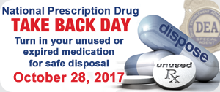

How do you dispose of opioids?
Notes:
ASK: How do you dispose of opioids?
Select participants willing to share their responses to this question.
[Limit to 5 minutes]
[40 minutes of 45 minute session is complete]
© 2017 Manworren & Lurie Children’s Hospital
All rights reserved. Version 2019

Slide 20
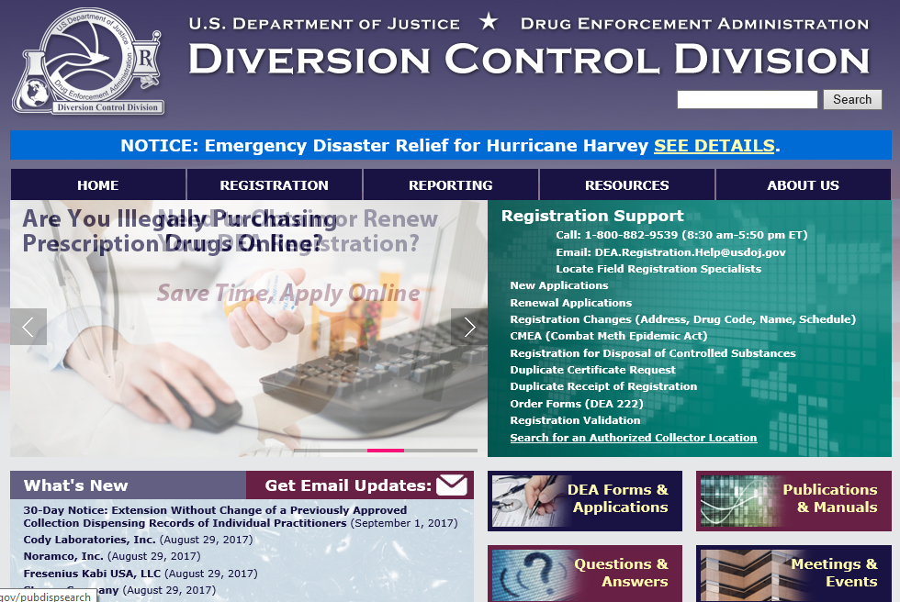
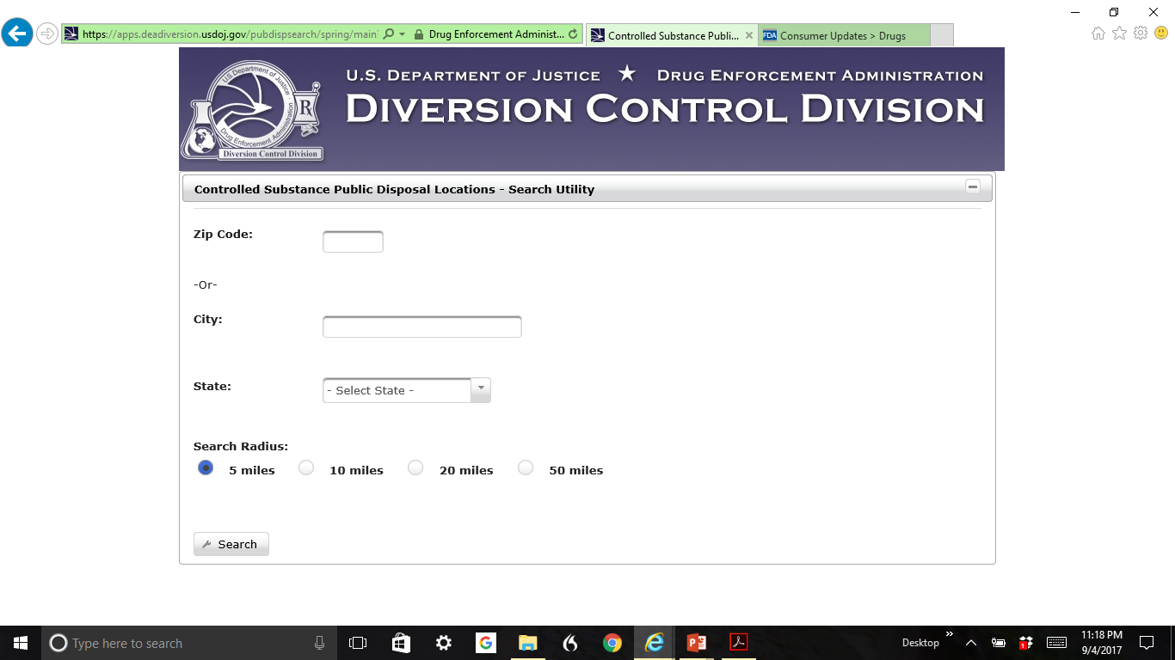
www.deadiversion.usdoj.gov
Search for an Authorized Collector Location
Then type in zip code or city and state
Notes:
READ:
Here is the website for DEA approved take-back sites. Simply type zip code into website to find a site.
Try it now on your mobile phone.
If there is not a disposal program readily available, instruct caregivers to:
Flush medications that could be dangerous to a child or pet- this includes ALL opioids!
OR
© 2017 Manworren & Lurie Children’s Hospital
All rights reserved. Version 2019

Slide 21
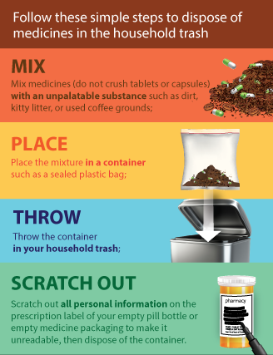
How to dispose of opioids
“While FDA and the EPA take the concerns of flushing certain medicines in the environment seriously, there has been no indication of environmental effects due to flushing.”
Notes:
READ:
Mix medications with an undesirable substance, (like coffee grounds), put in a sealed plastic bag, and throw them out in the trash
© 2017 Manworren & Lurie Children’s Hospital
All rights reserved. Version 2019

Slide 22
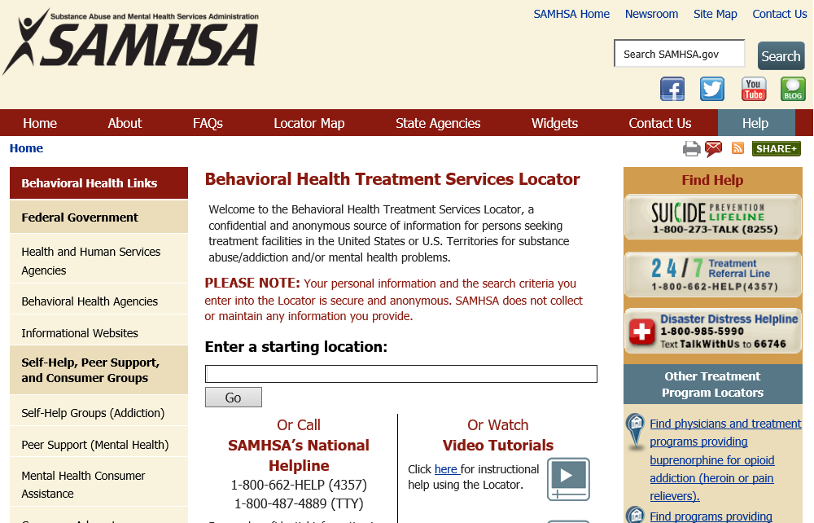
Be ready to refer
Be familiar with referral sources for abuse or addiction.
SAMHSA substance abuse treatment facility locator https://findtreatment.samhsa.gov/
Notes:
READ:
Be ready to refer for substance abuse treatment
Try to find referral programs now on your mobile phone.
© 2017 Manworren & Lurie Children’s Hospital
All rights reserved. Version 2019

Slide 23

Key Points
Opioids are indicated for severe pain and healthcare professionals must advocate for appropriate pain assessment, optimal multi-modal pain treatment and monitor for adverse treatment effects including adverse effects from opioids.
There is an opioid epidemic
Almost 1 in 4 young adults report non-medical use of opioids during their lifetime.
Legitimately prescribed opioid use before high school graduation is independently associated with a 33% increase in risk of future opioid misuse as a young adult (before 23 years of age).
Opioid dosing: ROSTERS
Risk assessment
Optimize multimodal for opioid-sparing effect
Start low, go slow
Titrate to effect
Evaluate efficacy
Reevaluate continued need for opioids
Secure, monitor, and dispose
Educate: What to Do
Educate parents on how to:
Secure the medications
Monitor opioid usage
Dispose of unused drugs
Take Back Days
DEA approved take-back sites
Disposal or Flush
Refer for substance use disorder treatment
Check the prescription drug monitoring program (PDMP)
Notes:
READ: The key points on the slide
© 2017 Manworren & Lurie Children’s Hospital
All rights reserved. Version 2019

Slide 24

How would you rate your ability to develop a plan of care for patients requiring opioids?
What resources do you need for your team to systemize anticipatory guidance for securing opioids in patients’ homes?
What is your next step?
Notes:
ASK: Are there any questions?
[45 minutes SESSION COMPLETE]

